Slide 1
Let S={a, bb, bab, abaab} be a set of strings. Are abbabaabab and baabbbabbaabb in S*? Does any word in S* have odd number of b’s?
Solution: since abbabaabab can be grouped as (a)(bb)(abaab)ab , which shows that the last member of the group does not belong to S, so abbabaabab is not in S*, while baabbbabbaabb can not be grouped as members of S, hence baabbbabbaabb is not in S*. Since each string in S has even number of b’s so there is no possiblity of any string with odd number of b’s to be in S*.

Slide 2
Q2) Prove that for any set of strings S
(S⁺)*=(S*)*
Solution: In general Λ is not in S⁺ , while Λ does belong to S*. Obviously Λ will now be in (S⁺)*, while (S*)* and S* generate the same set of strings. Hence (S⁺)*=(S*)*.

Slide 3
Q2) continued…
ii) (S⁺)⁺=S⁺
Solution: since S⁺ generates all possible strings that can be obtained by concatenating the strings of S, so (S⁺)⁺ generates all possible strings that can be obtained by concatenating the strings of S⁺ , will not generate any new string.
Hence (S⁺)⁺=S⁺

Slide 4
Q2) continued…
Is (S*)⁺=(S⁺)*
Solution: since Λ belongs to S* ,so Λ will belong to (S*)⁺ as member of S* .Moreover Λ may not belong to S⁺, in general, while Λ will automatically belong to (S⁺)*.
Hence (S*)⁺=(S⁺)*

Slide 5
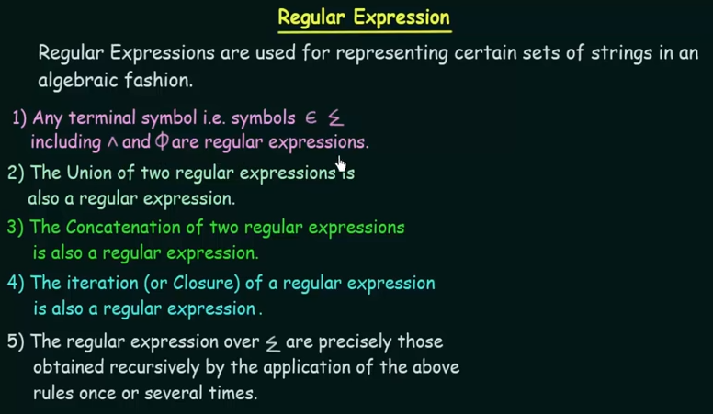

Slide 6
Regular Expression
As discussed earlier that a* generates
Λ, a, aa, aaa, …
and a⁺ generates a, aa, aaa, aaaa, …, so the language L₁ = {Λ, a, aa, aaa, …} and L₂ = {a, aa, aaa, aaaa, …} can simply be expressed by a* and a⁺, respectively.
a* and a⁺ are called the regular expressions (RE) for L₁ and L₂ respectively.
Note: a⁺, aa* and a*a generate L₂.

Slide 7
Recursive definition of Regular Expression(RE)
Step 1: Every letter of Σ including Λ is a regular expression.
Step 2: If r₁ and r2 are regular expressions then
  (r₁)
  r₁ r₂
  r₁ + r₂ and
  r₁*
  are also regular expressions.
Step 3: Nothing else is a regular expression.

Slide 8
Defining Languages (continued)…
Method 3 (Regular Expressions)
  Consider the language L={Λ, x, xx, xxx,…} of strings, defined over Σ = {x}.
  We can write this language as the Kleene star closure of alphabet Σ or L=Σ*={x}*
  this language can also be expressed by the regular expression x*.
  Similarly the language L={x, xx, xxx,…}, defined over Σ = {x}, can be expressed by the regular expression x⁺.

Slide 9
  Now consider another language L, consisting of all possible strings, defined over Σ = {a, b}. This language can also be expressed by the regular expression
  (a + b)*.
  Now consider another language L, of strings having exactly double a, defined over Σ = {a, b}, then it’s regular expression may be
  b*aab*

Slide 10
  Now consider another language L, of even length, defined over Σ = {a, b}, then it’s regular expression may be
  ((a+b)(a+b))*
  Now consider another language L, of odd length, defined over Σ = {a, b}, then it’s regular expression may be
  (a+b)((a+b)(a+b))* or
  ((a+b)(a+b))*(a+b)

Slide 11
Remark
It may be noted that a language may be expressed by more than one regular expressions, while given a regular expression there exist a unique language generated by that regular expression.

Slide 12
Example:
  Consider the language, defined over
  Σ={a , b} of words having at least one a, may be expressed by a regular expression
  (a+b)*a(a+b)*.
  Consider the language, defined over
  Σ = {a, b} of words having at least one a and one b, may be expressed by a regular expression
  (a+b)*a(a+b)*b(a+b)*+ (a+b)*b(a+b)*a(a+b)*.

Slide 13
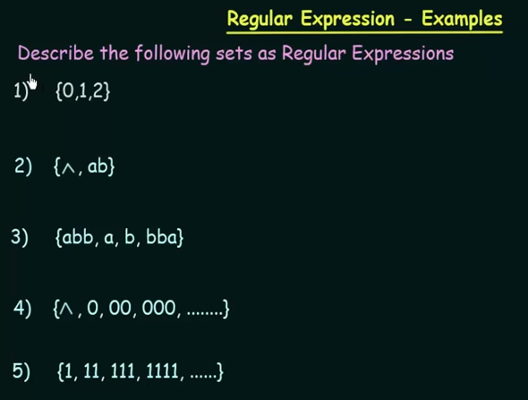

Slide 14
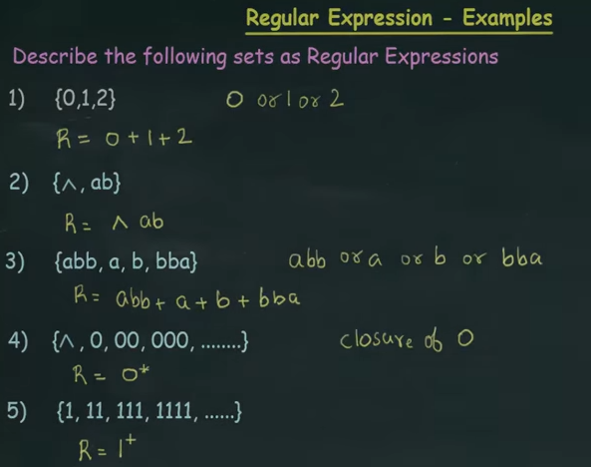

Slide 15
  Consider the language, defined over
  Σ={a, b}, of words starting with double a and ending in double b then its regular expression may be aa(a+b)*bb
  Consider the language, defined over
  Σ={a, b} of words starting with a and ending in b OR starting with b and ending in a, then its regular expression may be a(a+b)*b+b(a+b)*a

Slide 16
TASK
  Consider the language, defined over
  Σ={a, b} of words beginning with a
  Consider the language, defined over
  Σ={a, b} of words beginning and ending in same letter
  Consider the language, defined over
  Σ={a, b} of words ending in b
  Consider the language, defined over
  Σ={a, b} of words not ending in a,

